Slide 1
info@corporate-news.co.uk
MEDIA PACK

Slide 2
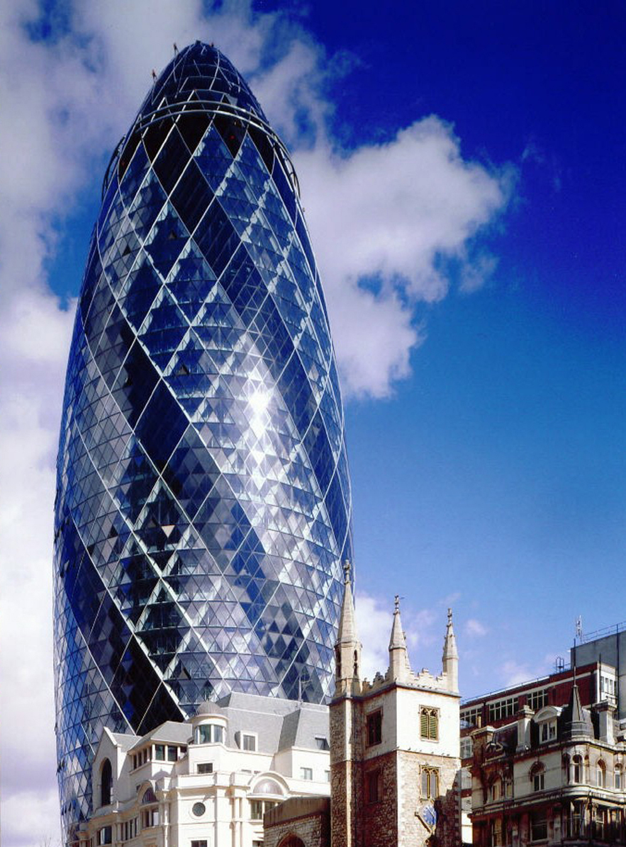
Welcome to Corporate-News.co.uk, the premier news media platform designed for professionals seeking to stay informed and connected. We feature in-depth articles that spotlight key developments across various regions and sectors, ensuring you never miss critical insights.
Our corporate recruitment platform is tailored to help professionals discover the latest job openings that align with their career goals. Additionally, we provide a dedicated space for showcasing corporate events, fostering networking opportunities, and building meaningful connections. With our business directory, professionals can easily generate leads and enhance their visibility for a simple subscription fee. Join us in navigating the evolving landscape of your industry and unlocking new opportunities for growth and collaboration.
​
To explore how we can support your professional journey, please contact us to arrange a meeting with one of our specialists. Together, we can unlock new opportunities for growth and collaboration.

Slide 3
How to Join our Corporate Community
https://www.corporate-news.co.uk/plans-pricing
Monthly News Letter - Subscribe to our Monthly News letter – get the latest Regional and Sector focused News direct to your email – free to sign up, once a month with focused news to your region
Feature News & Articles
Promote your News Article or Expert Opinion, With Corporate News
Your content, Your News, Your Opinion, on Corporate News
News Articles are issued the Following day
Select your Region & Sector
Write your article and attach images
Promoted on the Website & Linked In network.
Issued on our Monthly Newsletter shared in the Region.
Corporate News Subscription account can be used by multiple people within your team.
Expert Opinions

Slide 4
Promote your Job Description on Corporate-news.co.uk
Your content, Your News, Your Opinion, on Corporate News
Multiple Job Adverts under your profile
Recruiters Profile on Business Directory with their dedicated page
Your Content, Your Description, Your image
Attach Direct Web links, URL's and Email address
Key profiles will be listed on the news letter each month
Corporate News Subscription account can be used by multiple people within your team.
Corporate
Jobs & Recruiters
Promote your events on Corporate-news.co.uk
Event Details will be issued on Website
Issued on linked in posts
Attach - ticket link, URL's All info for example pictures Links
Events will stay live up until event date
Post up to one event a day to generate event awareness.
we aim to help to boost event reach and ticket sales.
Business Bio
Promote your Business on Corporate-news.co.uk
View and Search by all sectors, View and Search by all sectors, Contact details & Sector Focused
Corporate
Events &
Directory

Slide 5
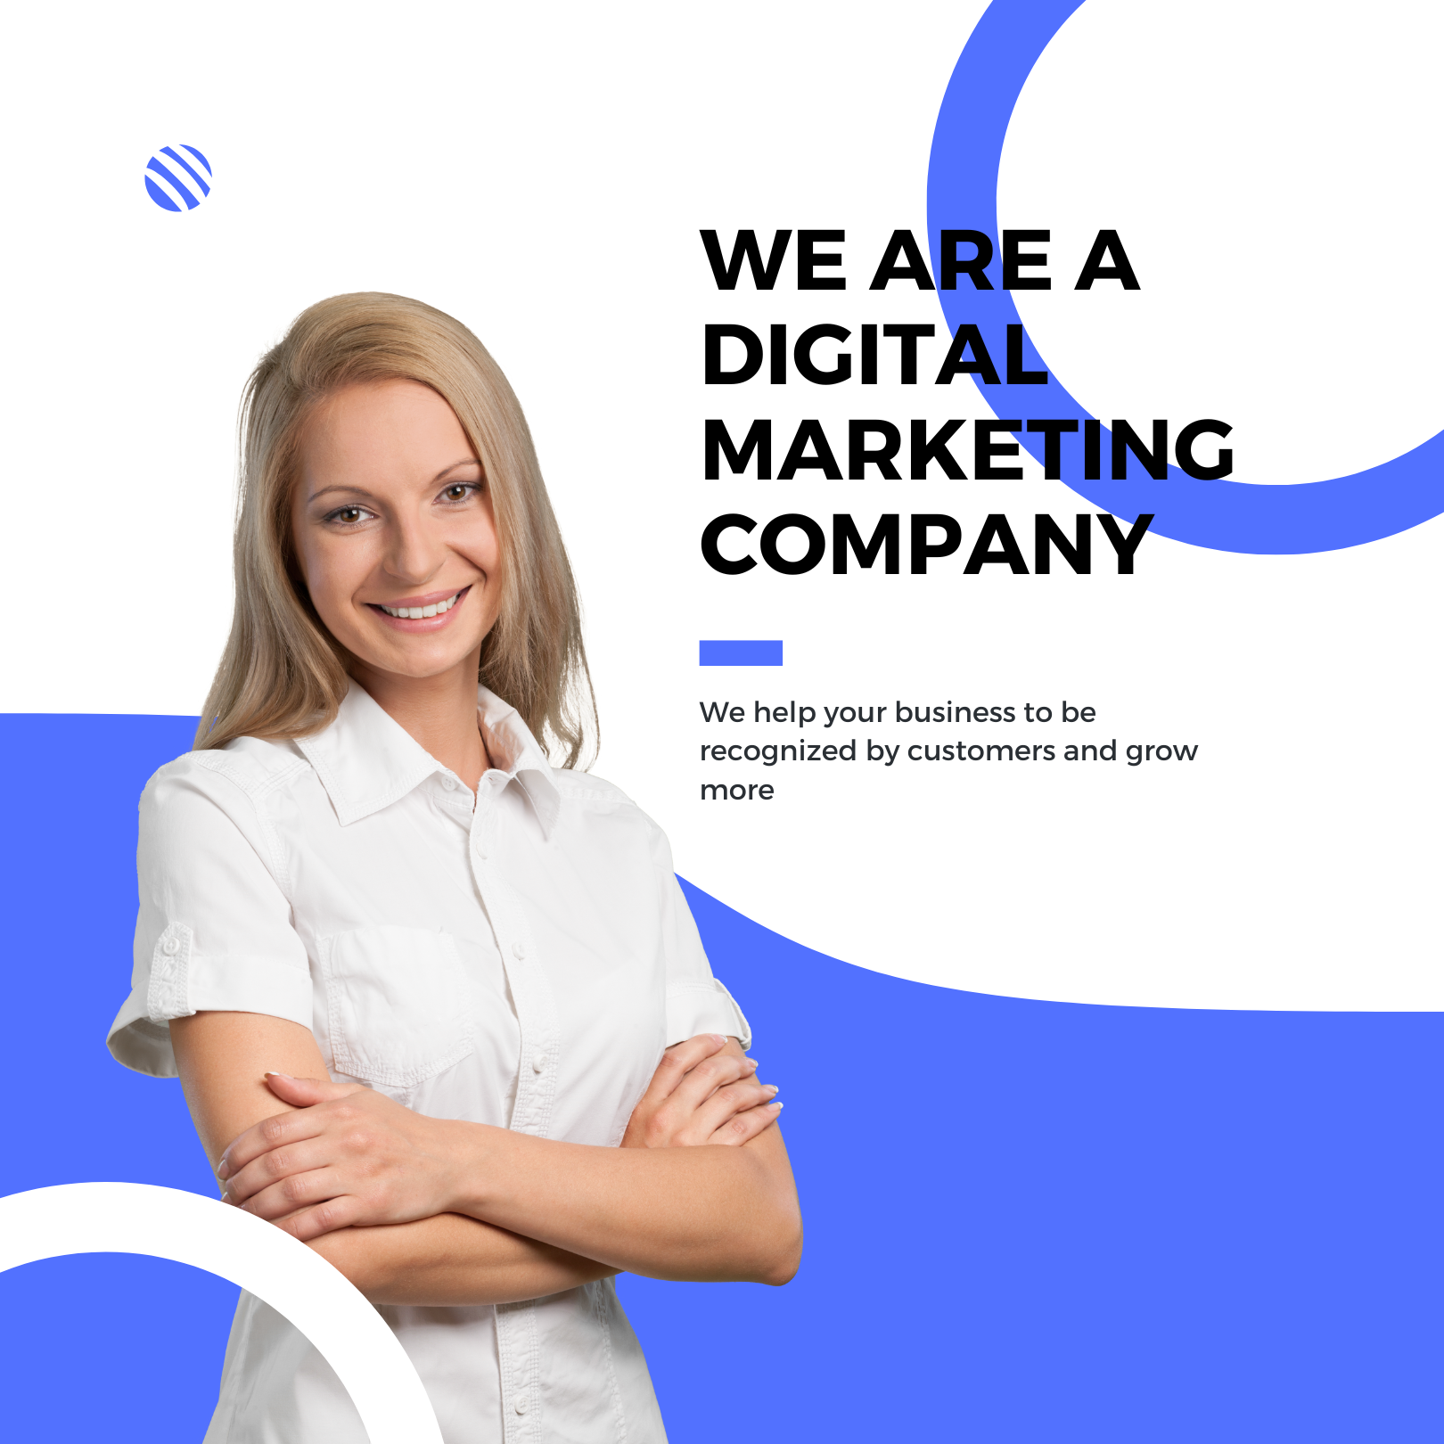
Advertisement
Advertisement
Home page
Top banner £200 PW
Middle Banner - £150 PW
8 x Regional Pages
Top banner £150 PW
Middle Banner - £150 PW
Top Banner Advertisement
MPU 1
Jobs & Recruiters
Top Banner £150 PW
Events
Top Banner £150 PW
MPU 2
Home page
MPU 1 – £200 PW
MPU 2 – 150 PW
5 x Sector Page
MPU 1 – £200 PW
MPU 2 – 150 PW
Jobs & Recruiters
MPU 1 x £200
MPU 2 x £150
Events
MPU 1 x £200
MPU 2 x £150

Slide 6
Join The Corporate Community
Get in touch!
Info@corporate-news.co.uk
https://www.corporate-news.co.uk/
Book in a teams call
Join our corporate Community

